Slide 1


README
How to use this presentation
1
2
3
Make a copy of this presentation!
⚠️This document will be deleted in 30 days.
Customize and use it however you’d like
Once you make a copy, you can edit this just like any other Google Slides presentation.
You can also download the presentation as a PowerPoint and PDF, and more.
Try Plus AI for free
Get the Plus AI extensions to generate and edit presentations directly in Google Slides and PowerPoint.
Learn more and start your free trial at plusdocs.com

Slide 2


ER Model in Database Management Systems
June 27, 2024

Slide 3
Agenda
Introduction to ER Model
Example of ER Model
Components of ER Model
Entities in ER Model
Types of Attributes
Key Attribute Example
Types of Relationships
ER Model Summary

Slide 4


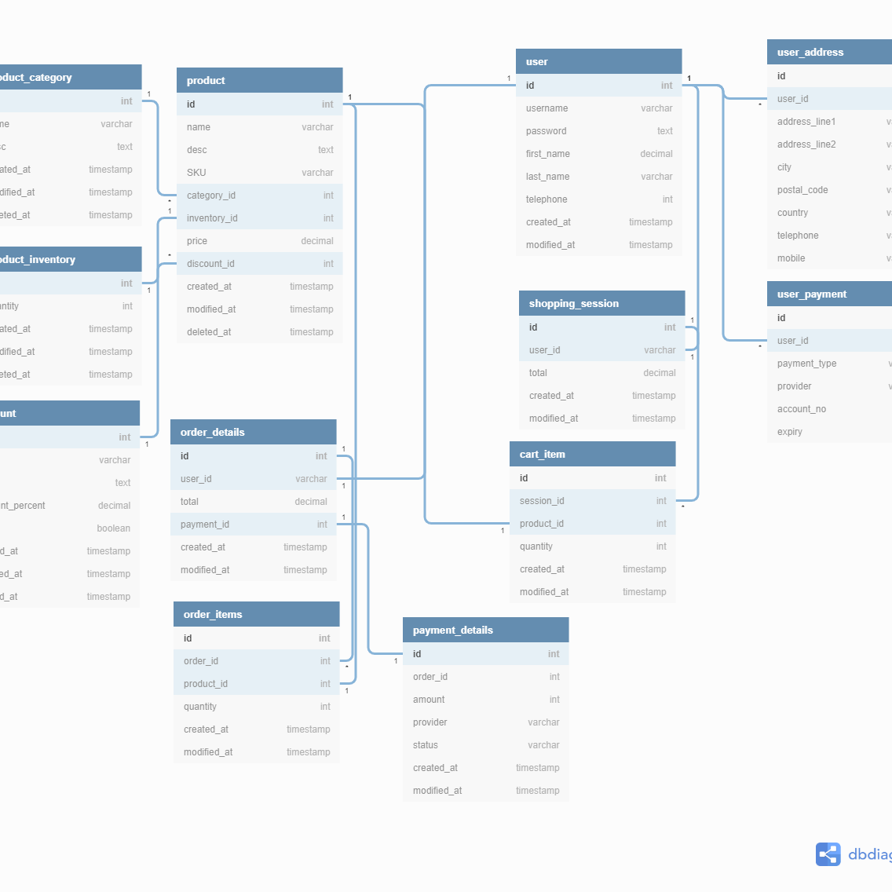
Introduction to ER Model
Plus tip:
Customize the slide by incorporating specific examples of databases relevant to your audience, such as a university database or an e-commerce website database.
Understanding the ER Model
The Entity Relationship (ER) Model is a high-level conceptual model used to design databases.
It represents the relationship between different elements within a database.
ER Models help to visualize database structure, making it easier to understand and design.
The model is simple and easy to design, aiding in creating a clear database schema.

Slide 5

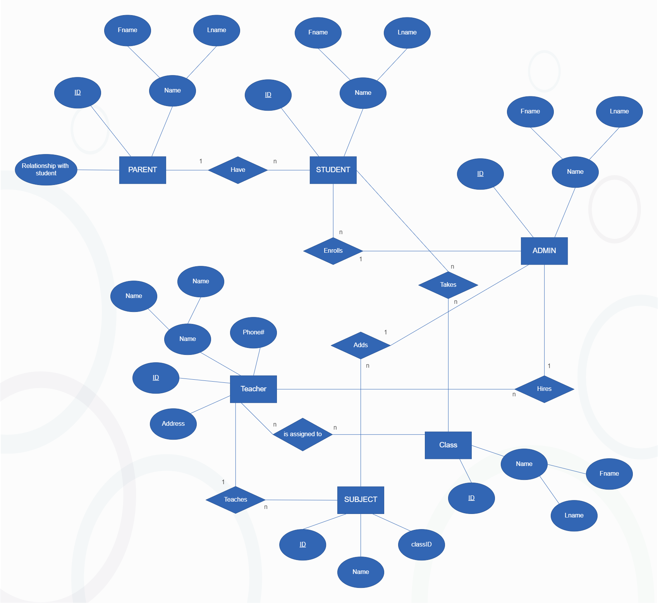

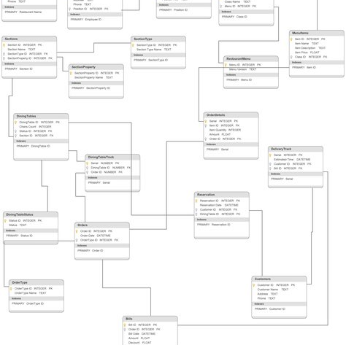
Example of ER Model
Plus tip:
Customize this slide by adding specific details or additional entities and attributes relevant to your audience's field or interest.
School Database ER Model
In a school database ER Model, the primary entity is 'Student'. Attributes include 'Name', 'Address', and 'Student ID'. Each student entity can also have relationships with other entities such as 'Course' and 'Teacher'.
Other ER Diagrams
ER diagrams can also be created for various systems like railway reservation, organization databases, airline reservation systems, and hotel management systems. Each system will have its own unique entities and relationships.

Slide 6

Components of ER Model
Entity
Attributes
Relations
An entity represents a real-world object or concept, such as a person, place, or event. Entities are depicted using rectangles in ER diagrams.
Attributes provide additional information about an entity. They describe properties or characteristics of the entity and are depicted using ellipses.
Relations describe how entities are related to each other. They define the interactions between entities and are depicted using diamond shapes.
Plus tip:
Customize this slide by adding specific examples relevant to your audience's industry or domain. Include visual aids like diagrams for better understanding.

Slide 7


Entities in ER Model
Plus tip:
Customize this slide with specific examples from your database design project to make it more relatable.
What is an Entity?
An entity represents any object, class, person, or place.
Entities are represented by rectangles in ER diagrams.
Examples include customer, student, teacher, etc.
Strong vs. Weak Entities
Strong entities have a primary key and are independent.
Weak entities depend on strong entities and lack a primary key.
Strong entities are represented by single rectangles, weak entities by double rectangles.

Slide 8

Types of Attributes
Key Attribute
Represents the primary key or main characteristic of an entity. Example: Student ID in a student entity. Represented by an ellipse with an underlined text.
Composite Attribute
An attribute that can be divided into sub-attributes. Example: Name divided into First Name, Middle Name, and Last Name. Represented by an ellipse.
Multi-valued Attribute
An attribute that can hold multiple values. Example: Student’s phone numbers. Represented by a double oval.
Derived Attribute
An attribute whose value can be derived from other attributes. Example: Age derived from Date of Birth. Represented by a dashed ellipse.
Plus tip:
To customize this slide, include specific examples from your own database schema to illustrate each type of attribute.

Slide 9
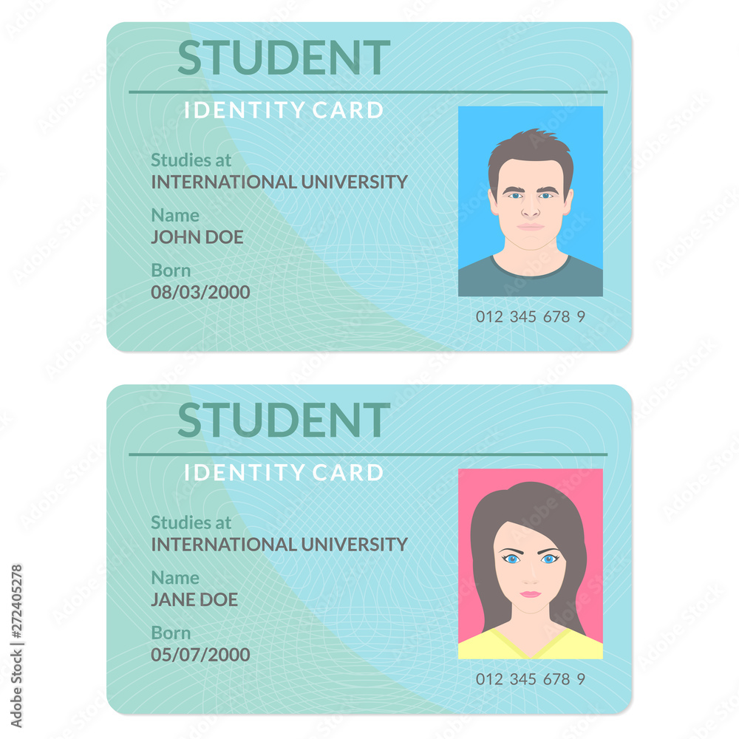
Key Attribute Example
Plus tip:
You can customize this slide by replacing the student entity example with any entity relevant to your database, such as Employee ID in a company database or Product ID in an inventory system.
Example of Key Attribute in Student Entity
A key attribute uniquely identifies each instance of an entity in the database.
For a student entity, the Student ID or Roll Number is a key attribute.
Each student has a unique ID which serves as the primary key.
Key attributes are represented by an ellipse with the attribute name underlined.
Example: Student(ID, Name, Age) where ID is the key attribute.

Slide 10

Types of Relationships
One-to-One
One instance of an entity on both sides. Example: A female married to a male – one female can marry one male and vice versa.
One-to-Many
One instance on one side and multiple instances on the other. Example: A scientist can invent multiple inventions, but each invention is tied to one scientist.
Many-to-One
Multiple instances on one side and one instance on the other. Example: Many students enroll in one course, but each course is taken by many students.
Many-to-Many
Multiple instances on both sides. Example: Multiple employees are assigned to multiple projects, and each project can have multiple employees.
Plus tip:
Use specific examples from your organization’s database to make the relationship types more relatable for your audience.

Slide 11

ER Model Summary
Plus tip:
Customize this slide by adding specific examples or case studies relevant to your audience to better illustrate the concepts.
ER Model (Entity Relationship Model) is a high-level conceptual framework used to design databases.
Key components of an ER Model include entities, attributes, and relationships, each playing a crucial role in database structuring.
Entities represent real-world objects or concepts, attributes describe their properties, and relationships illustrate associations between entities.
Understanding different types of entities (strong and weak) and attributes (key, composite, multi-valued, derived) is essential for accurate database modeling.
Mastering ER Models enables efficient database design, ensuring data integrity, organization, and scalability.

Slide 12
Thank you

